Slide 1
Vector compression
KV-CACHE COMPRESSION — VECTOR COMPRESSION
Using spatial locality of sparsity to compress vectors with minimal accuracy loss.
Aron Isaacs · advised by Freddy · Deck creation co-piloted by Claude
October 2026
Notes:
Three parts: (1) per-scalar sparsification stored with run-length encoding (RLE), and its measured saving; (2) RoPE-paired sparsification of keys, its RLE saving and GSM8K accuracy; (3) bitmask encoding and net compression after metadata. All measurements use Llama 3.1 8B-Instruct.

Slide 2
Sparsify, then store with run-length encoding (RLE)
THE COMPRESSION ALGORITHM
The KV cache stores a key (K) and a value (V) vector of 128 bf16 numbers per token, per head.
1. Sparsify: set the smallest-magnitude values in the vector to zero.
2. Encode: store only the non-zero values, plus each group of consecutive zeros as one 2-byte overhead tile: a (start, length) pair, 1 byte each.
Example: a 16-value vector, 50% sparsity
Position
0
1
2
3
4
5
6
7
8
9
10
11
12
13
14
15
Original
0.82
−0.05
0.03
1.10
−0.64
0.02
−0.01
0.07
0.45
−0.90
0.04
0.38
−0.02
−0.06
0.71
0.09
Sparsified (50%)
0.82
0
0
1.10
−0.64
0
0
0
0.45
−0.90
0
0.38
0
0
0.71
0.09
0.82
1.10
−0.64
0.45
−0.90
0.38
0.71
0.09
(1, 2)
(5, 3)
(10, 1)
(12, 2)
Stored
2 bytes
2 bytes
2 bytes
2 bytes
256 bits uncompressed → 128 bits of values + 4 overhead tiles × 2 bytes (16 bits each) = 64 bits of RLE = 192 bits, 25% smaller.
Zero-groups: 4 groups of lengths 2, 3, 1 and 2 values, so the average zero-group length is (2 + 3 + 1 + 2) ÷ 4 = 2.0 values.
02 / 17
Vector Compression
Notes:
Toy example with 16 values; real K and V head vectors have 128 values. The 8 smallest-magnitude values (positions 1, 2, 5, 6, 7, 10, 12, 13) are set to zero. They form 4 zero-groups: positions 1-2 (length 2), 5-7 (length 3), 10 (length 1) and 12-13 (length 2), stored as the (start, length) pairs shown. Each pair takes 2 bytes. Decoding writes the stored values back in order and fills each group with zeros.

Slide 3
RLE saving by average zero-group length, per K or V head vector (128 bf16 values):
RUN-LENGTH ENCODING
Each zero-group is stored as one overhead tile and frees 16 bits for every bf16 value it covers. Measured with per-scalar sparsification at a uniform rate on every K and V vector (128 values). Llama 3.1 8B-Instruct, CEval text, all 32 layers.
2 bytes
Each overhead tile: one (start, length) pair, 1 byte for the start and 1 byte for the length = 16 bits per zero-group.
Sparsity (uniform, every vector) | Avg zero-group length (values) | Zero-groups per vector | effective compression | GSM8K, Llama 3.1 8B-Instruct (same budget)
0% (dense baseline) | – | – | 0% | 77.7%
10% | 1.10 | 10.93 | 0.8% | 76.9%
20% | 1.24 | 20.17 | 3.8% | 77.0%
30% | 1.42 | 26.72 | 8.8% | 76.1%
40% | 1.66 | 30.64 | 15.9% | 75.5%
50% | 2.00 | 31.97 | 25.0% | 74.5%
60% | 2.46 | 30.91 | 35.2% | 67.6%
Net saving = (16 × average group length − 16) × groups per vector ÷ 2,048 bits (128 × 16).
RLE saves space whenever the average group is longer than 1 value.
03 / 17
Vector Compression
Notes:
GSM8K column: per-scalar sparsification at the same budget (slide 10).. Dense baseline 77.7%. Per 128-value head vector, bf16 (2,048 bits uncompressed). Values zeroed = floor(128 x sparsity): 12, 25, 38, 51, 64, 76. Average zero-group length = values zeroed / mean number of zero-groups per vector (measured: 10.93, 20.17, 26.72, 30.64, 31.97, 30.91), with per-scalar sparsification (vector_compress) at that uniform rate on every K and V vector, Llama 3.1 8B-Instruct, keys counted in llama.cpp's layout (adjacent RoPE pairs), values as stored, 4,096 tokens of CEval validation text (compression_topics/vector/figures/llamacpp_zero_groups_local.json). Bits freed per group = 16 x average length. RLE cost = 16 bits per group (1-byte start, 1-byte length). Net saving = (bits freed - 16 bits) per group x groups per vector / 2,048 = (values zeroed - groups) / 128. Measured vs. expected under random placement (10.97, 20.32, 27.02, 31.08, 32.49, 31.47 groups): within about 1.8%. Other encodings change the 16 bits per group, which moves the break-even length but not the dependence on group length.

Slide 4
RoPE-Paired Sparsification of Keys
PART 2
Keys are sparsified one RoPE pair at a time. Values have no positional rotation and keep per-scalar sparsification.
04 / 17
Vector Compression

Slide 5
A pair's energy a² + b² is unchanged by the RoPE rotation:
ROPE-PAIRED SPARSIFICATION
Derivation
Example: pair (a, b) = (0.45, −0.90), a² + b² = 1.0125
RoPE rotates each pair (a, b) = (x[2i], x[2i+1]) by an angle θ set by the token position and the pair index i:
Before RoPE
0.45
−0.90
a² + b² = 1.0125
a′ = a cos θ − b sin θ
b′ = a sin θ + b cos θ
↓ rotate by θ = 60°
After RoPE
1.004
−0.060
a² + b² = 1.0125
a′² + b′² = a² cos² θ − 2ab sin θ cos θ + b² sin² θ
+ a² sin² θ + 2ab sin θ cos θ + b² cos² θ
Angle θ | a′ | b′ | a′² + b′²
0° | 0.450 | −0.900 | 1.0125
90° | 0.900 | 0.450 | 1.0125
135° | 0.318 | 0.955 | 1.0125
200° | −0.731 | 0.692 | 1.0125
= a² (cos² θ + sin² θ) + b² (sin² θ + cos² θ) = a² + b²
The pair score a² + b² is the same before and after RoPE, for any position and any pair index.
05 / 17
Vector Compression
Notes:
RoPE applies a 2D rotation to each pair of features (x[2i], x[2i+1]) in llama.cpp's Llama layout (RoPE type NORM), with angle theta = position x base^(-2i/d). A rotation preserves the squared length of the 2D vector, so the pair score a^2 + b^2 is identical for the unrotated and the rotated key. The same pairs are selected whether the score is computed before or after RoPE. Example pair (0.45, -0.90) is pair 4 of the 16-value toy key vector used on the next slides; a^2 + b^2 = 0.2025 + 0.81 = 1.0125. Values (V) are not rotated.

Slide 6
Example: a 16-value key vector, 50% sparsity
ROPE-PAIRED SPARSIFICATION
A key vector is a 1D array in memory: x[0], x[1], …, x[15]. In llama.cpp, RoPE rotates each value with its adjacent neighbour, the pair (x[2i], x[2i+1]); each pair is drawn in one box. Pairs are scored by a² + b²; the weakest are set to zero, both values together.
Position j
0
1
2
3
4
5
6
7
8
9
10
11
12
13
14
15
Pair i
0
1
2
3
4
5
6
7
Key vector x[j]
0.82
−0.05
0.03
1.10
−0.64
0.02
−0.01
0.07
0.45
−0.90
0.04
0.38
−0.02
−0.06
0.71
0.09
Pair score a² + b²
0.67
1.21
0.41
0.005
1.01
0.15
0.004
0.51
Sparsified
0.82
−0.05
0.03
1.10
0
0
0
0
0.45
−0.90
0
0
0
0
0.71
0.09
Stored
0.82
−0.05
0.03
1.10
0.45
−0.90
0.71
0.09
(2, 2)
(5, 2)
2 bytes
2 bytes
4 of 8 pairs set to zero = 8 of 16 values. Both values of a pair share one zero decision, so the RLE groups run over pair index: 128 bits of values + 2 overhead tiles × 2 bytes (16 bits each) = 160 bits, vs. 256.
06 / 17
Vector Compression
Notes:
Toy example with d = 16, pairs (2i, 2i+1) as in llama.cpp's Llama layout (RoPE type NORM). Llama 3.1 keys have d = 128 per head: 64 adjacent pairs per vector. a² + b² is the squared length of the pair, which RoPE's rotation does not change. Pair scores: 0.6749, 1.211, 0.41, 0.005, 1.013, 0.146, 0.004, 0.5122; the 4 lowest (pairs 2, 3, 5, 6) are zeroed, 8 of 16 values. Stored, in one row: the kept pairs in their original order (pairs 0, 1, 4, 7, each as its two adjacent values), then the RLE groups over pair index: pairs 2-3 (length 2), pairs 5-6 (length 2). One (start, length) pair, 2 bytes, describes the zeros of both values in each pair. 160 bits vs. 256 uncompressed, 37.5% smaller. Same 16 numbers as the example on slide 2.

Slide 7
RLE saving by average zero-group length on one key head (64 pairs):
RUN-LENGTH ENCODING, ROPE-PAIRED
RLE runs over the 64 pair positions, once for both values of each pair. Each zero-group is stored as one overhead tile and frees 32 bits for every pair it covers (2 bf16 values). Measured with RoPE-paired sparsification at a uniform rate on every K vector. Llama 3.1 8B-Instruct, CEval text, all 32 layers.
2 bytes
Each overhead tile: one (start, length) pair, 1 byte for the start and 1 byte for the length = 16 bits per zero-group.
Sparsity (uniform, every vector) | Avg zero-group length (pairs) | Zero-groups per vector | effective compression | GSM8K, Llama 3.1 8B-Instruct (same budget)
0% (dense baseline) | – | – | 0% | 77.7%
10% | 1.11 | 5.39 | 5.2% | 78.3%
20% | 1.26 | 9.54 | 11.3% | 76.6%
30% | 1.46 | 13.03 | 19.5% | 76.0%
40% | 1.68 | 14.92 | 27.4% | 77.0%
50% | 2.03 | 15.80 | 37.7% | 72.2%
60% | 2.47 | 15.39 | 47.3% | 46.6%
Net saving = (32 × average group length − 16) × groups per vector ÷ 2,048 bits (128 × 16).
07 / 17
Vector Compression
Notes:
GSM8K column: RoPE-paired keys with per-scalar values at the same budget (slide 10).. Dense baseline 77.7%. Per 128-value key head vector, bf16 (2,048 bits uncompressed) = 64 RoPE pairs (2i, 2i+1), as in llama.cpp. Pairs zeroed = floor(64 x sparsity): 6, 12, 19, 25, 32, 38. Average zero-group length = pairs zeroed / mean number of zero-groups on the 64-position pair mask (measured: 5.39, 9.54, 13.03, 14.92, 15.80, 15.39), with RoPE-paired sparsification (vector_compress_pair) at that uniform rate on every K vector, Llama 3.1 8B-Instruct, 4,096 tokens of CEval validation text (llamacpp_zero_groups_local.json). Bits freed per group = 32 x average length (two bf16 values per pair). RLE cost = 16 bits per group (1-byte start, 1-byte length), stored once for both values of a pair. Net saving = (bits freed - 16) per group x groups per vector / 2,048 = (32 x pairs zeroed - 16 x groups) / 2,048. Expected group counts under random placement on the pair mask: 5.53, 9.94, 13.66, 15.63, 16.50, 16.03; measured counts are 2.6% to 4.6% lower. Values (V) are not rotated and use per-scalar sparsification, as on slide 3.

Slide 8
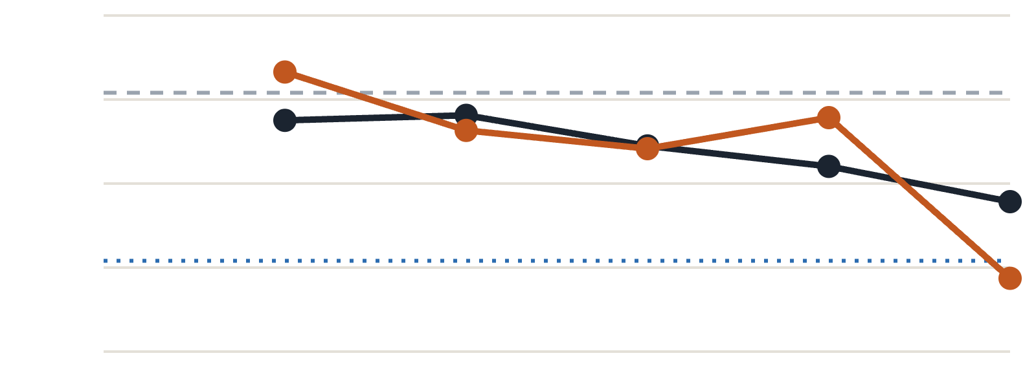
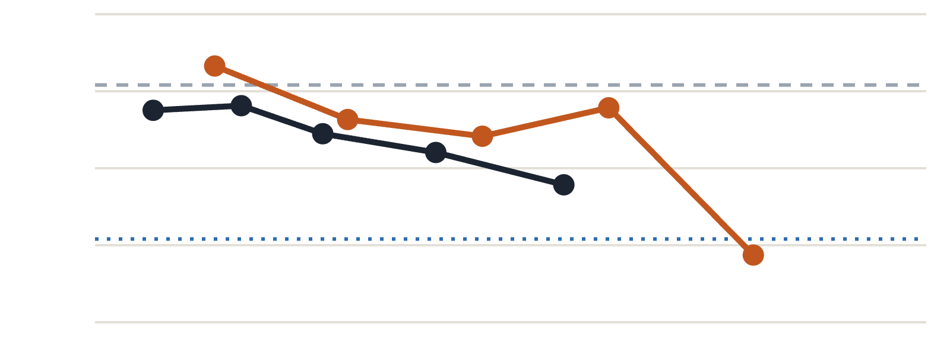
Accuracy results for GSM8K:
RESULTS
Llama 3.1 8B-Instruct, GSM8K, budgets 10–50% (60% in the table on slide 10). Both runs compress K and V together, per layer, via greedy selection; "paired" means RoPE-paired keys plus per-scalar values. Budget = average share of K/V values removed across all 64 K/V slots. Right: RLE metadata at 2 bytes per zero-group; RoPE-paired assumes every compressed slot is a key, RLE's best case.
● Per-scalar sparsification
● RoPE-paired sparsification
— — Dense baseline (77.7%)
· · · 5 points below dense (72.7%)
Without RLE metadata overhead · x = budget
With RLE metadata overhead · x = net compression
80%
80%
77.5%
77.5%
75%
75%
72.5%
72.5%
70%
70%
0%
10%
20%
30%
40%
50%
0%
10%
20%
30%
40%
50%
Compression budget (% of K/V values set to zero)
Net compression after RLE metadata (% of KV cache bits saved)
Through 40% the two are tied (every gap within 1.5 points). With RLE metadata, the 50% budget gives per-scalar 28.2% net compression at 74.5% accuracy, RoPE-paired 39.6% at 72.2%.
09 / 17
Vector Compression
Notes:
Left: GSM8K accuracy against compression budget. Right: the same runs against net compression after RLE metadata = (bits removed − RLE metadata bits) ÷ uncompressed KV bits, summed over the 64 K/V slots of each run's greedy assignment; uncompressed slots cost nothing. RLE: 16 bits × zero-groups per vector, measured for that exact layer, target and level (25/50/75%) on 4,096 tokens of CEval validation text with Llama 3.1 8B-Instruct, keys in llama.cpp's layout (rle_slot_groups.json); RoPE-paired keys count groups over the 64 pairs; RoPE-paired points use the all-keys assumption. Points (budget: net compression with RLE, GSM8K): per-scalar 10%: 3.5%, 76.9%; 20%: 8.8%, 77.0%; 30%: 13.7%, 76.1%; 40%: 20.5%, 75.5%; 50%: 28.2%, 74.5%; RoPE-paired 10%: 7.2%, 78.3%; 20%: 15.2%, 76.6%; 30%: 23.3%, 76.0%; 40%: 30.9%, 77.0%; 50%: 39.6%, 72.2%. The 60% budget is not plotted (per-scalar 38.0% net, 67.6%; RoPE-paired 49.7% net, 46.6%; the 60% gap is far outside the noise). Dotted blue line: 5 percentage points below the 77.7% dense baseline (72.7%). Noise: with 1319 questions at about 77% accuracy, one score has a standard error of about 1.2 points, so a gap of 1.5 points between two methods is not meaningful. The 10% point (78.3% paired vs 76.9% per-scalar) is a tie, not a win. Slide 16 shows the same runs with a bitmask instead of RLE.

Slide 9
GSM8K accuracy, per-scalar vs. RoPE-paired sparsification (Llama 3.1 8B-Instruct):
RESULTS IN DETAIL
Budget | Per-scalar — accuracy | Per-scalar degredation | RoPE-paired — accuracy | RoPE-paired degredation
Dense (0%) | 77.7% | 0.0 | 77.7% | 0.0
10% | 76.9% | −0.8 | 78.3% | +0.6
20% | 77.0% | −0.7 | 76.6% | −1.1
30% | 76.1% | −1.6 | 76.0% | −1.7
40% | 75.5% | −2.2 | 77.0% | −0.8
50% | 74.5% | −3.3 | 72.2% | −5.5
60% | 67.6% | −10.1 | 46.6% | −31.1
Same six budgets as the chart; Δ is points off the 77.7% dense baseline. Both columns compress K and V per layer, via greedy selection — Per-scalar sparsifies both plainly; RoPE-paired pairs keys by RoPE rotation and still sparsifies values the plain way.
10 / 17
Vector Compression

Slide 10
RoPE-paired sparsification: keys and values
ROPE-PAIRED SPARSIFICATION
Keys → paired sparsification
Values → per-scalar sparsification
Pair each value with its neighbour, (2i, 2i+1), the pairs llama.cpp's RoPE rotates together. Score each pair by a²+b² and zero the weakest pairs, both values at once. RoPE rotates each pair, which leaves a²+b² unchanged, so the pair's score is the same before and after RoPE.
V is not rotated by RoPE, so there are no pairs to keep together. Values use per-scalar sparsification, as on slide 2.
Paired V has not been measured against per-scalar V.
07 / 17
Vector Compression

Slide 11
Bitmask Encoding
PART 3
Storing one bit per value instead of RLE groups, and the net compression it gives for per-scalar and RoPE-paired sparsification.
11 / 17
Vector Compression

Slide 12
Sparsify, then store with a bitmask
BITMASK ENCODING
1. Sparsify: set the smallest-magnitude values in the vector to zero, as before.
2. Encode: store only the non-zero values, plus one bit per position: 1 = value kept, 0 = zero. For RoPE-paired keys, one bit per pair.
Example: the same 16-value vector as slide 2, 50% sparsity
Position
0
1
2
3
4
5
6
7
8
9
10
11
12
13
14
15
Sparsified (50%)
0.82
0
0
1.10
−0.64
0
0
0
0.45
−0.90
0
0.38
0
0
0.71
0.09
Bitmask
1
0
0
1
1
0
0
0
1
1
0
1
0
0
1
1
Stored
0.82
1.10
−0.64
0.45
−0.90
0.38
0.71
0.09
1001100011010011
256 bits uncompressed → 128 bits of values + 16 bits of bitmask = 144 bits, 43.75% smaller (RLE: 192 bits).
12 / 17
Vector Compression
Notes:
Same toy vector and zeroed positions (1, 2, 5, 6, 7, 10, 12, 13) as slide 2. The bitmask has one bit per position, 1 where the value is kept: 1001100011010011. Its size is fixed (16 bits here, 128 bits for a real 128-value head vector, 64 bits for a RoPE-paired key with one bit per pair), no matter how the zeros are grouped. Decoding walks the mask: for each 1 it takes the next stored value, for each 0 it writes a zero. On this vector RLE needs 4 groups x 16 bits = 64 bits of metadata vs. 16 bits for the bitmask.

Slide 13
Replacing RLE with a bitmask raises the savings:
ENCODING IMPROVEMENT
Bitmask: 1 bit per value marks zero or non-zero. RLE: 16 bits per zero-group. Per-scalar sparsification, same measured vectors as slide 3 (Llama 3.1 8B-Instruct, CEval text, all 32 layers.)
6.25%
Fixed bitmask overhead: always 128 bits per vector (128 of 2,048 bits), at every sparsity level, however the zeros are grouped.
Sparsity | Net saving, RLE | Net saving, bitmask | improvement from RLE
10% | 0.8% | 3.1% | +2.3
20% | 3.8% | 13.3% | +9.5
30% | 8.8% | 23.4% | +14.6
40% | 15.9% | 33.6% | +17.7
50% | 25.0% | 43.8% | +18.7
60% | 35.2% | 53.1% | +17.9
Bitmask net saving = (16 × values zeroed − 128) ÷ 2,048 bits.
The bitmask is smaller than RLE whenever a vector has more than 8 zero-groups (8 × 16 = 128 bits). Every measured sparsity level has 11 to 32.
The bitmask is also simpler to implement: it has a fixed size and a fixed place in memory, and decoding is one expand of the stored values by the mask (one SVE2.2 EXPAND per vector chunk). RLE is variable-length and must be read group by group to find where each value goes.
13 / 17
Vector Compression
Notes:
Per 128-value head vector, bf16 (2,048 bits). Values zeroed = floor(128 x sparsity): 12, 25, 38, 51, 64, 76. RLE metadata = 16 bits x measured zero-groups per vector (per-scalar sparsification, uniform rate on every K and V vector, Llama 3.1 8B-Instruct, keys in llama.cpp's layout, as on slide 3). RLE net saving = (values zeroed - groups) / 128, as on slide 3. Bitmask net saving = (16 x values zeroed - 128) / 2,048. Break-even: RLE and bitmask cost the same at 8 zero-groups per vector; below 8 groups RLE is smaller. Implementation: a bitmask has a fixed size (128 bits, 64 for RoPE-paired keys) at a fixed offset, so the mask for any token can be located directly and decoded in parallel: the mask chunk becomes the predicate of an expand (SVE2.2 EXPAND, or a table lookup on NEON). RLE has a variable number of groups per vector, so its metadata needs per-vector lengths or offsets and a sequential walk over the groups to place each value.

Slide 14
RoPE-paired keys: one mask bit per pair
BITMASK ENCODING, ROPE-PAIRED
A key vector is a 1D array in memory, and RoPE pairs adjacent values (x[2i], x[2i+1]); each pair is drawn in one box. Both values of a pair are kept or zeroed together, so one bit describes the pair: 1 = pair kept, 0 = pair zeroed. A 128-value key vector has 64 pairs, so a 64-bit mask.
Example: the same 16-value key vector as slide 6, 50% sparsity
Position j
0
1
2
3
4
5
6
7
8
9
10
11
12
13
14
15
Pair i
0
1
2
3
4
5
6
7
Sparsified
0.82
−0.05
0.03
1.10
0
0
0
0
0.45
−0.90
0
0
0
0
0.71
0.09
Pair bitmask
1
1
0
0
1
0
0
1
Stored
0.82
−0.05
0.03
1.10
0.45
−0.90
0.71
0.09
11001001
256 bits uncompressed → 128 bits of values + 8 bits of bitmask = 136 bits, 46.9% smaller (RLE: 160 bits).
14 / 17
Vector Compression
Notes:
Same toy key vector and pair decisions as slide 6: pairs (2i, 2i+1) as in llama.cpp; pairs 2, 3, 5 and 6 have the lowest a² + b² and are zeroed (8 of 16 values). The pair bitmask, 1 where the pair is kept, is 11001001: 8 bits for 8 pairs, half the 16 bits of the per-scalar mask on slide 12. Stored: the kept pairs in their original order (each pair as its two adjacent values), then the mask. Decoding walks the mask: for each 1 it takes the next pair of stored values, for each 0 it writes two zeros. RLE on the same vector needs 2 groups x 16 bits = 32 bits of metadata vs. 8 bits for the pair bitmask. A real 128-value key has 64 pairs, so a 64-bit mask. Values (V) are not paired and keep the 1-bit-per-value mask.

Slide 15
RoPE-paired keys with a bitmask:
ENCODING IMPROVEMENT, ROPE-PAIRED KEYS
Bitmask: 1 bit per RoPE pair. RLE: 16 bits per zero-group over the 64 pairs. RoPE-paired sparsification of keys, same measured vectors as slide 8 (Llama 3.1 8B-Instruct, CEval text, all 32 layers).
3.125%
Fixed bitmask overhead: always 64 bits per key vector (64 of 2,048 bits), at every sparsity level, however the zeros are grouped.
Sparsity | Net saving, RLE | Net saving, bitmask | improvement from RLE
10% | 5.2% | 6.3% | +1.1
20% | 11.3% | 15.6% | +4.3
30% | 19.5% | 26.6% | +7.1
40% | 27.4% | 35.9% | +8.5
50% | 37.7% | 46.9% | +9.2
60% | 47.3% | 56.3% | +8.9
Bitmask net saving = (32 × pairs zeroed − 64) ÷ 2,048 bits.
The bitmask is smaller than RLE whenever a key vector has more than 4 zero-groups (4 × 16 = 64 bits). Every measured sparsity level has 5.4 to 15.8.
15 / 17
Vector Compression
Notes:
Per 128-value key head vector, bf16 (2,048 bits) = 64 RoPE pairs (2i, 2i+1), as in llama.cpp. Pairs zeroed = floor(64 x sparsity): 6, 12, 19, 25, 32, 38. Zero-groups per vector measured on the 64-position pair mask with RoPE-paired sparsification at that uniform rate on every K vector, Llama 3.1 8B-Instruct, CEval validation text (as on slide 8). RLE metadata = 16 bits x groups. RLE net saving = (32 x pairs zeroed - 16 x groups) / 2,048, as on slide 8. Bitmask net saving = (32 x pairs zeroed - 64) / 2,048. Break-even at 4 zero-groups per vector. Values (V) are not paired; their RLE vs. bitmask numbers are the per-scalar ones on slide 13.

Slide 16
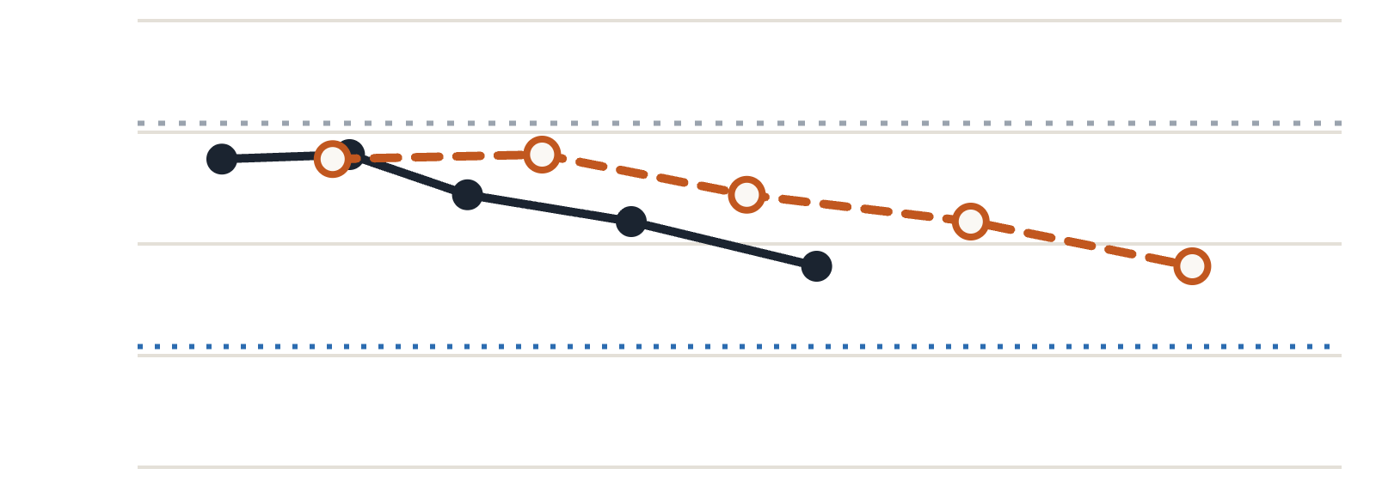
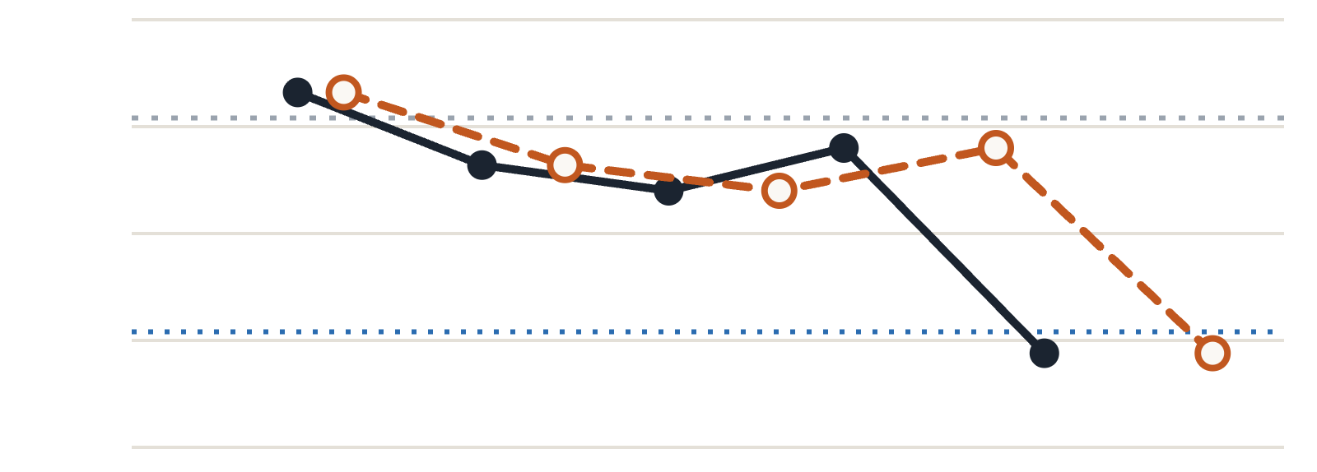
Bitmask vs RLE (with overhead):
RESULTS WITH METADATA
Llama 3.1 8B-Instruct, GSM8K, same runs as slide 9, budgets 10–50% (60% results on slide 10). Metadata: RLE (2 bytes per zero-group) or bitmask (1 bit per value; per pair for RoPE-paired keys). RoPE-paired curves assume every compressed slot is a key, RLE's best case.
● RLE (solid)
○ Bitmask (dashed)
· · Dense baseline (77.7%)
· · · 5 points below dense (72.7%)
y-axis: GSM8K accuracy
Per-scalar · bitmask gain +4.6 to +15.6 points
RoPE-paired (all keys) · bitmask gain +2.0 to +7.3 points
80%
80%
77.5%
77.5%
75%
75%
72.5%
72.5%
70%
70%
0%
10%
20%
30%
40%
50%
0%
10%
20%
30%
40%
50%
Net compression after metadata (% of KV cache bits saved)
Net compression after metadata (% of KV cache bits saved)
Highest net compression with a bitmask (50% budget): per-scalar 43.8% at 74.5% accuracy, RoPE-paired 46.9% at 72.2%.
16 / 17
Vector Compression
Notes:
Dotted blue line: 5 percentage points below the 77.7% dense baseline (72.7%). Net compression = (bits removed − metadata bits) ÷ uncompressed KV bits, summed over the 64 K/V slots of each run's greedy assignment; uncompressed slots cost nothing. RLE: 16 bits × zero-groups per vector, measured for that exact layer, target and level (25/50/75%) on 4,096 tokens of CEval validation text with Llama 3.1 8B-Instruct, keys in llama.cpp's layout (rle_slot_groups.json); RoPE-paired keys count groups over the 64 pairs. Bitmask: 128 bits per compressed vector, 64 bits for RoPE-paired keys. Accuracy is the GSM8K score from slide 9. Points (the 60% budget is not plotted; its values are listed for reference): per-scalar budget 10%: RLE net 3.5%, bitmask net 8.1%, GSM8K 76.9%; per-scalar budget 20%: RLE net 8.8%, bitmask net 16.8%, GSM8K 77.0%; per-scalar budget 30%: RLE net 13.7%, bitmask net 25.3%, GSM8K 76.1%; per-scalar budget 40%: RLE net 20.5%, bitmask net 34.6%, GSM8K 75.5%; per-scalar budget 50%: RLE net 28.2%, bitmask net 43.8%, GSM8K 74.5%; per-scalar budget 60%: RLE net 38.0%, bitmask net 53.9%, GSM8K 67.6%; paired budget 10%: RLE net 7.2%, bitmask net 9.2% (all-keys assumption; with the run's actual K/V mix 4.7% and 8.5%), GSM8K 78.3%; paired budget 20%: RLE net 15.2%, bitmask net 18.8% (all-keys assumption; with the run's actual K/V mix 11.3% and 17.7%), GSM8K 76.6%; paired budget 30%: RLE net 23.3%, bitmask net 28.1% (all-keys assumption; with the run's actual K/V mix 18.1% and 26.7%), GSM8K 76.0%; paired budget 40%: RLE net 30.9%, bitmask net 37.5% (all-keys assumption; with the run's actual K/V mix 25.1% and 35.9%), GSM8K 77.0%; paired budget 50%: RLE net 39.6%, bitmask net 46.9% (all-keys assumption; with the run's actual K/V mix 34.1% and 45.4%), GSM8K 72.2%; paired budget 60%: RLE net 49.7%, bitmask net 57.0% (all-keys assumption; with the run's actual K/V mix 44.7% and 55.5%), GSM8K 46.6%. RoPE-paired all-keys assumption: every compressed slot (K or V) is costed as a paired key at that layer and level, RLE's lowest-overhead case (paired keys need about half the zero-groups of per-scalar values; the cheapest RLE slot anywhere still costs at least 2.3x its bitmask). Script: compression_topics/vector/scripts/rle_net_compression.py; results in rle_net_compression.json.

Slide 17
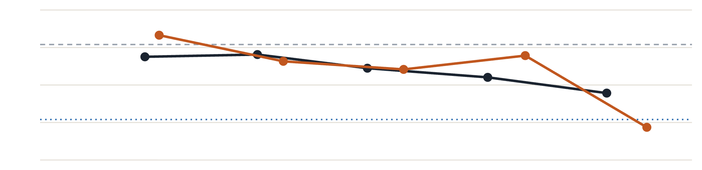
Bit-mask scalar vs bit-mask RoPE (with overhead):
RESULTS WITH BITMASK METADATA
Llama 3.1 8B-Instruct, GSM8K, same runs as slide 9, budgets 10–50%. x = net compression after bitmask metadata (1 bit per value; per pair for RoPE-paired keys), % of KV cache bits saved. RoPE-paired assumes every compressed slot is a key.
● Per-scalar sparsification
● RoPE-paired sparsification
— — Dense baseline (77.7%)
· · · 5 points below dense (72.7%)
80%
77.5%
GSM8K accuracy
75%
72.5%
70%
0%
10%
20%
30%
40%
50%
Net compression after bitmask metadata (% of KV cache bits saved)
Highest net compression with a bitmask (50% budget): per-scalar 43.8% at 74.5% accuracy, RoPE-paired 46.9% at 72.2%.
17 / 17
Vector Compression
Notes:
Net compression = (bits removed − bitmask bits) ÷ uncompressed KV bits, summed over the 64 K/V slots of each run's greedy assignment; uncompressed slots cost nothing. Bitmask: 128 bits per compressed vector, 64 bits for RoPE-paired keys. RoPE-paired points use the all-keys assumption (every compressed slot costed as a paired key). Accuracy is the GSM8K score from slide 9. Points (budget: net compression with bitmask, GSM8K): per-scalar 10%: 8.1%, 76.9%; 20%: 16.8%, 77.0%; 30%: 25.3%, 76.1%; 40%: 34.6%, 75.5%; 50%: 43.8%, 74.5%; RoPE-paired 10%: 9.2%, 78.3%; 20%: 18.8%, 76.6%; 30%: 28.1%, 76.0%; 40%: 37.5%, 77.0%; 50%: 46.9%, 72.2%. The 60% budget is not plotted (per-scalar 53.9% net, 67.6%; RoPE-paired 57.0% net, 46.6%). Dotted blue line: 5 percentage points below the 77.7% dense baseline (72.7%). Slide 9 (right chart) shows the same runs with RLE metadata.

